Slide 1
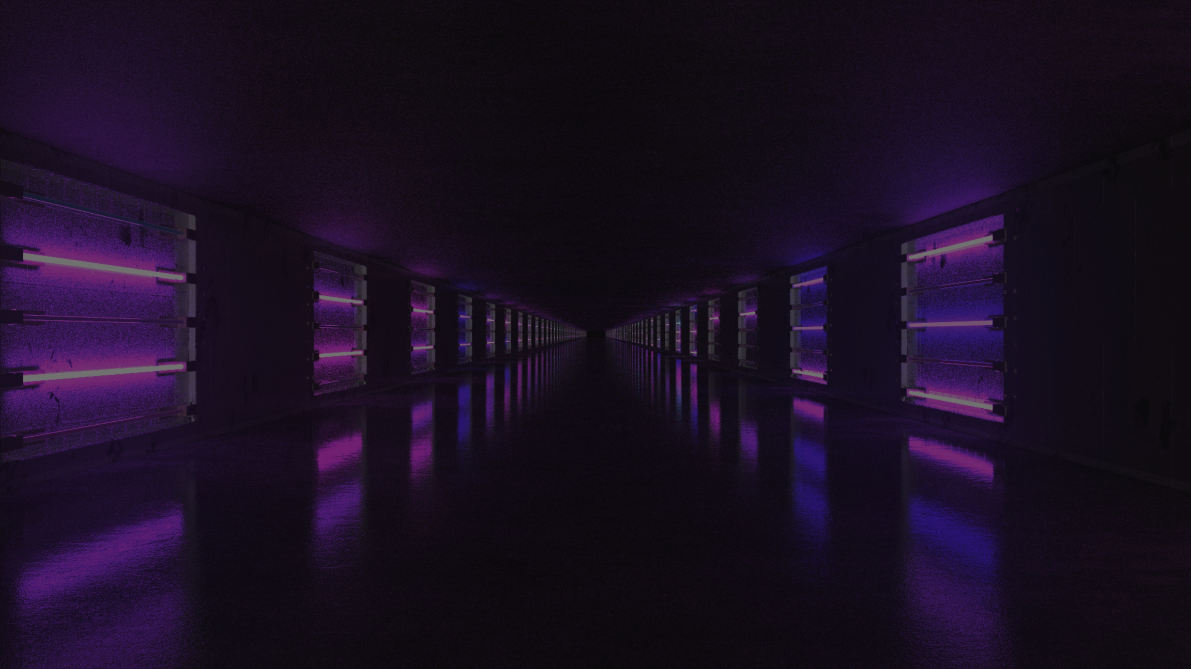

MOVIEVERSE
AN INTEGRATED ENTERTAINMENT PLATFORM FOR SEAMLESS
CONTENT DISCOVERY AND PERSONALIZED VIEWING.
PIYUSH | PRANAVI | SAVNEET

Slide 2



INTRODUCTION
MovieVerse is a modern movie discovery platform designed to make finding and exploring movies more personalized and engaging. It combines intelligent search, advanced filters, AI-powered recommendations, and watchlist management in one seamless experience. With a premium cinematic design and local data architecture, MovieVerse delivers a smooth and independent movie exploration experience.
SEAMLESS EXPLORATION
CINEMATIC DESIGN
PERSONALIZED EXPERIENCE

Slide 3





MEMBER - 1
Intelligent Search
Reusable Movie Cards
Video Carousel
Text-Based Recommendations
Like • Play • Explore
Seamless • Interactive • Immersive
AI Features
Add to Watchlist
AI-powered recommendations
Save • Track • Access

Slide 4



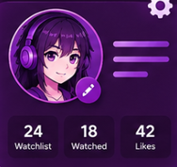

MEMBER - 2
Authentication Page
Anime Ecosystem
Watch History
Login • Secure • Access
Works even without API
Track • Review • Revisit
Profile
Search Bar upgradation
Personalize • Manage • Track
Queries both movies and anime

Slide 5





MEMBER - 3
Kids Entertainment
TV & Drama
Movies
Curated • Safe • Engaging
Use reusable movie card components
Implemented platform integration
Content Architecture : Implemented structured category organization
Maintained premium aesthetic and cohesive design language across all content

Slide 6
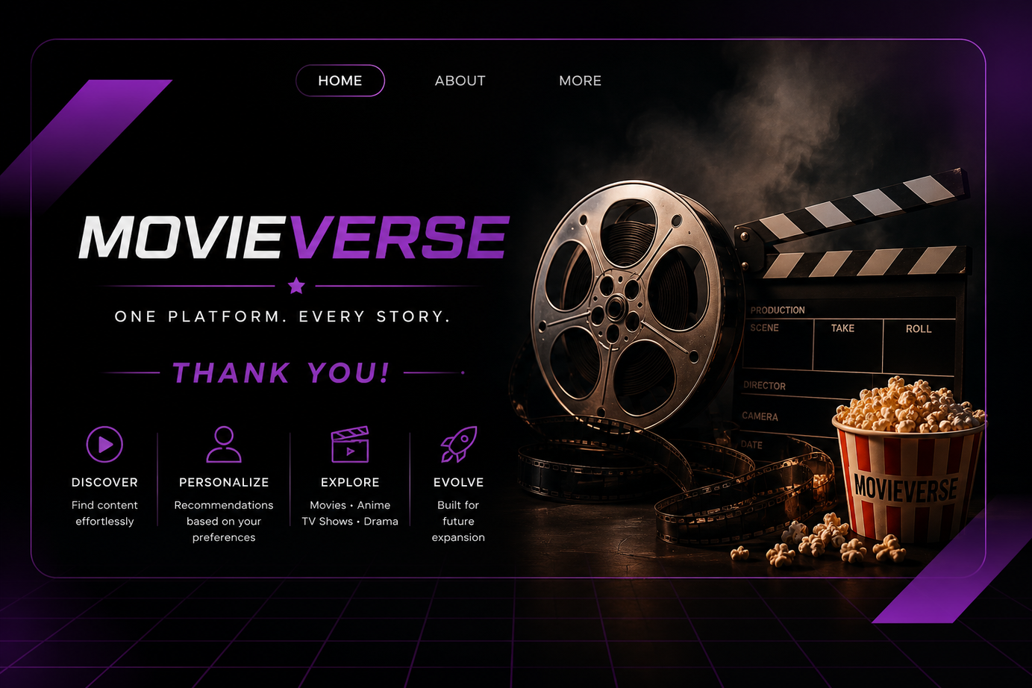
CONCLUSION
Personalized Discovery — Delivers intelligent and tailored content exploration.
Premium User Experience: Visually sophisticated interface featuring dark theme with refined golden accents
Technical Independence: Self-contained local data architecture minimizing external API dependencies and improving system reliability
Scalable Architecture: Modular component design and robust state management infrastructure enabling seamless future feature expansion

Slide 7

TECH - STACK
1
2
3
4
HTML
CSS3
Javascript
React.js

Slide 8
THANK YOU!

